Slide 1
ENGR 290
Bonding

Slide 2
Bonding
Electronegativity:
Electronegativity is the tendency of an atom to gain an electron. Atoms with a high electronegativity are typically towards the right side of the periodic table.
Electropositive is the tendency of an atom to loose an electron. These atoms are towards the left side of the periodic table.
The highly electronegative atoms typically attract to the highly positive atoms to create ionic molecules and ceramics.

Slide 3
Ionic Bonds
Ionic bonds tend to form between strongly electronegative and strongly electropositive atoms.
The outer (valence) electrons of the electropositive atom are transferred to the outer electron energy levels of the electronegative atom. Positive and negative ions are formed that are attracted by a Coulombic force, which is an omidirectional force.
  eg. Na and Cl form NaCl where the properties of the resultant material (salt) is very different from either of the atoms. Cl and Na are both highly corrosive where Cl is associated with acids and Na is associated with bases.
What can you guess about the electrical conductivity of ionic solids?
Conduct when molten (or in solution) but not when solid.
What would you expect about their melting temperatures - high or low? High

Slide 4
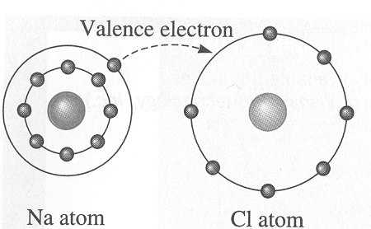
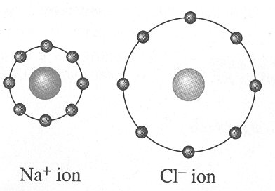
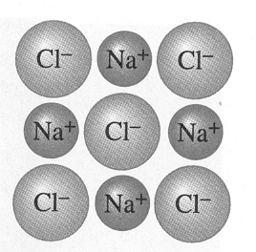
An ionic bond is created between two unlike atoms with different electronegativities.
When sodium donates its valence electron to chlorine, each becomes an ion; attraction occurs, and the ionic bond is formed.
The transferred electron is strongly attached to its new host, the negative ion. Therefore, material is poor electron conductor.
The size of the Cl ion is big compared to its elemental size whereas the size of Na ion is small compared to its elemental size.

Slide 5
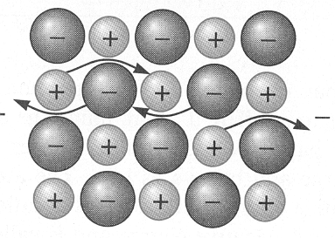
When a voltage is applied to an ionic material, entire ions must move to cause a current to flow. Ion movement is slow and the electrical conductivity is poor. Thus ionic materials like SiO₂ and Al₂O₃ make good insulators of electricity.
Fuel cells must transfer H+ and OH- ions to recombine to release electrons for power and to form water.

Slide 6
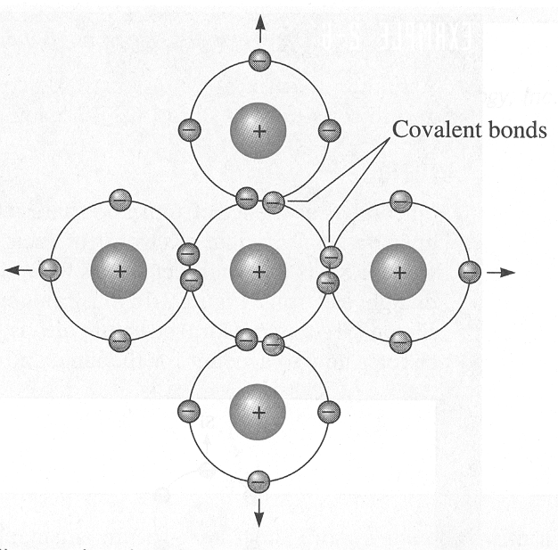
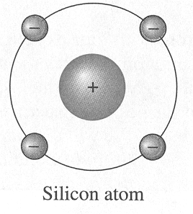
Covalent Bonds
Materials with covalent bonds tend to occur among atoms with no or small differences in electronegativity and therefore the elements are close to one another in the periodic table.
Two or more atoms share two or more electrons.
The atoms most commonly share their outer s and p electrons so that each atom can tend to approach an inert gas structure.
Example, Si; Z = 14; 1s² 2s² 2p⁶ 3s² 3p² or 1s² 2s² 2p⁶ 3s¹ 3p³ are possible with the second configuration being more stable.
Silicon wants 3s² 4p⁶

Slide 7
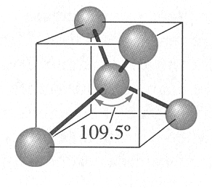
Covalent Bonds
While ionic bonds are omnidirectional, covalent bonds are very directional so atoms can best share their electrons.
Covalent bonds are very strong.
  They tend to be brittle with poor electrical conductivity. Why then is Silicon and other like materials used in the electronics industry?
  Many hydrocarbons, eg., C₂ H₄ , are covalently bonded. What has covalently bonding materials enabled to be formed on Earth and probably other planets?
  Many polymer materials such as polyvinyl chloride (PVC), used as molded plastic on cars, have primarily covalent bonds.

Slide 8
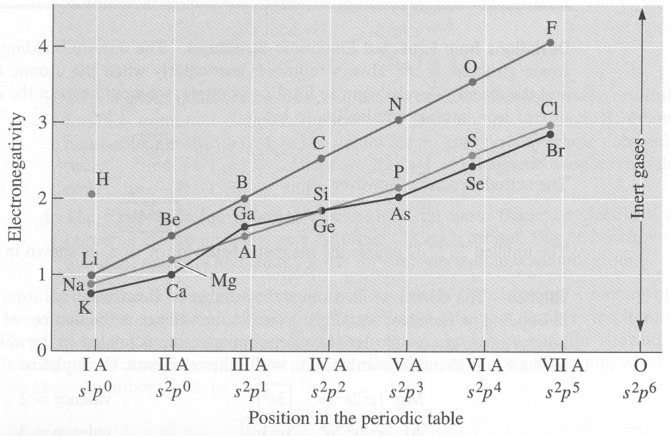
Metallic Bonds
Metallic bonds occurs in Metallic elements, which tend to have a low electronegativity.
A metallic bond is non-directional
The outer (valence) electrons are given up to form a “sea of mobile electrons”, which are attracted by a set of fixed positive ion cores.
  These mobile electrons are called “conduction” electrons and they form the “glue” to bond the metal atoms together.
  The sharing of electrons produces a lower energy state than when the individual atoms are collected separately
  Where do the elements that form metallic bonds exist
  on the periodic table?
  (see next slide)

Slide 9
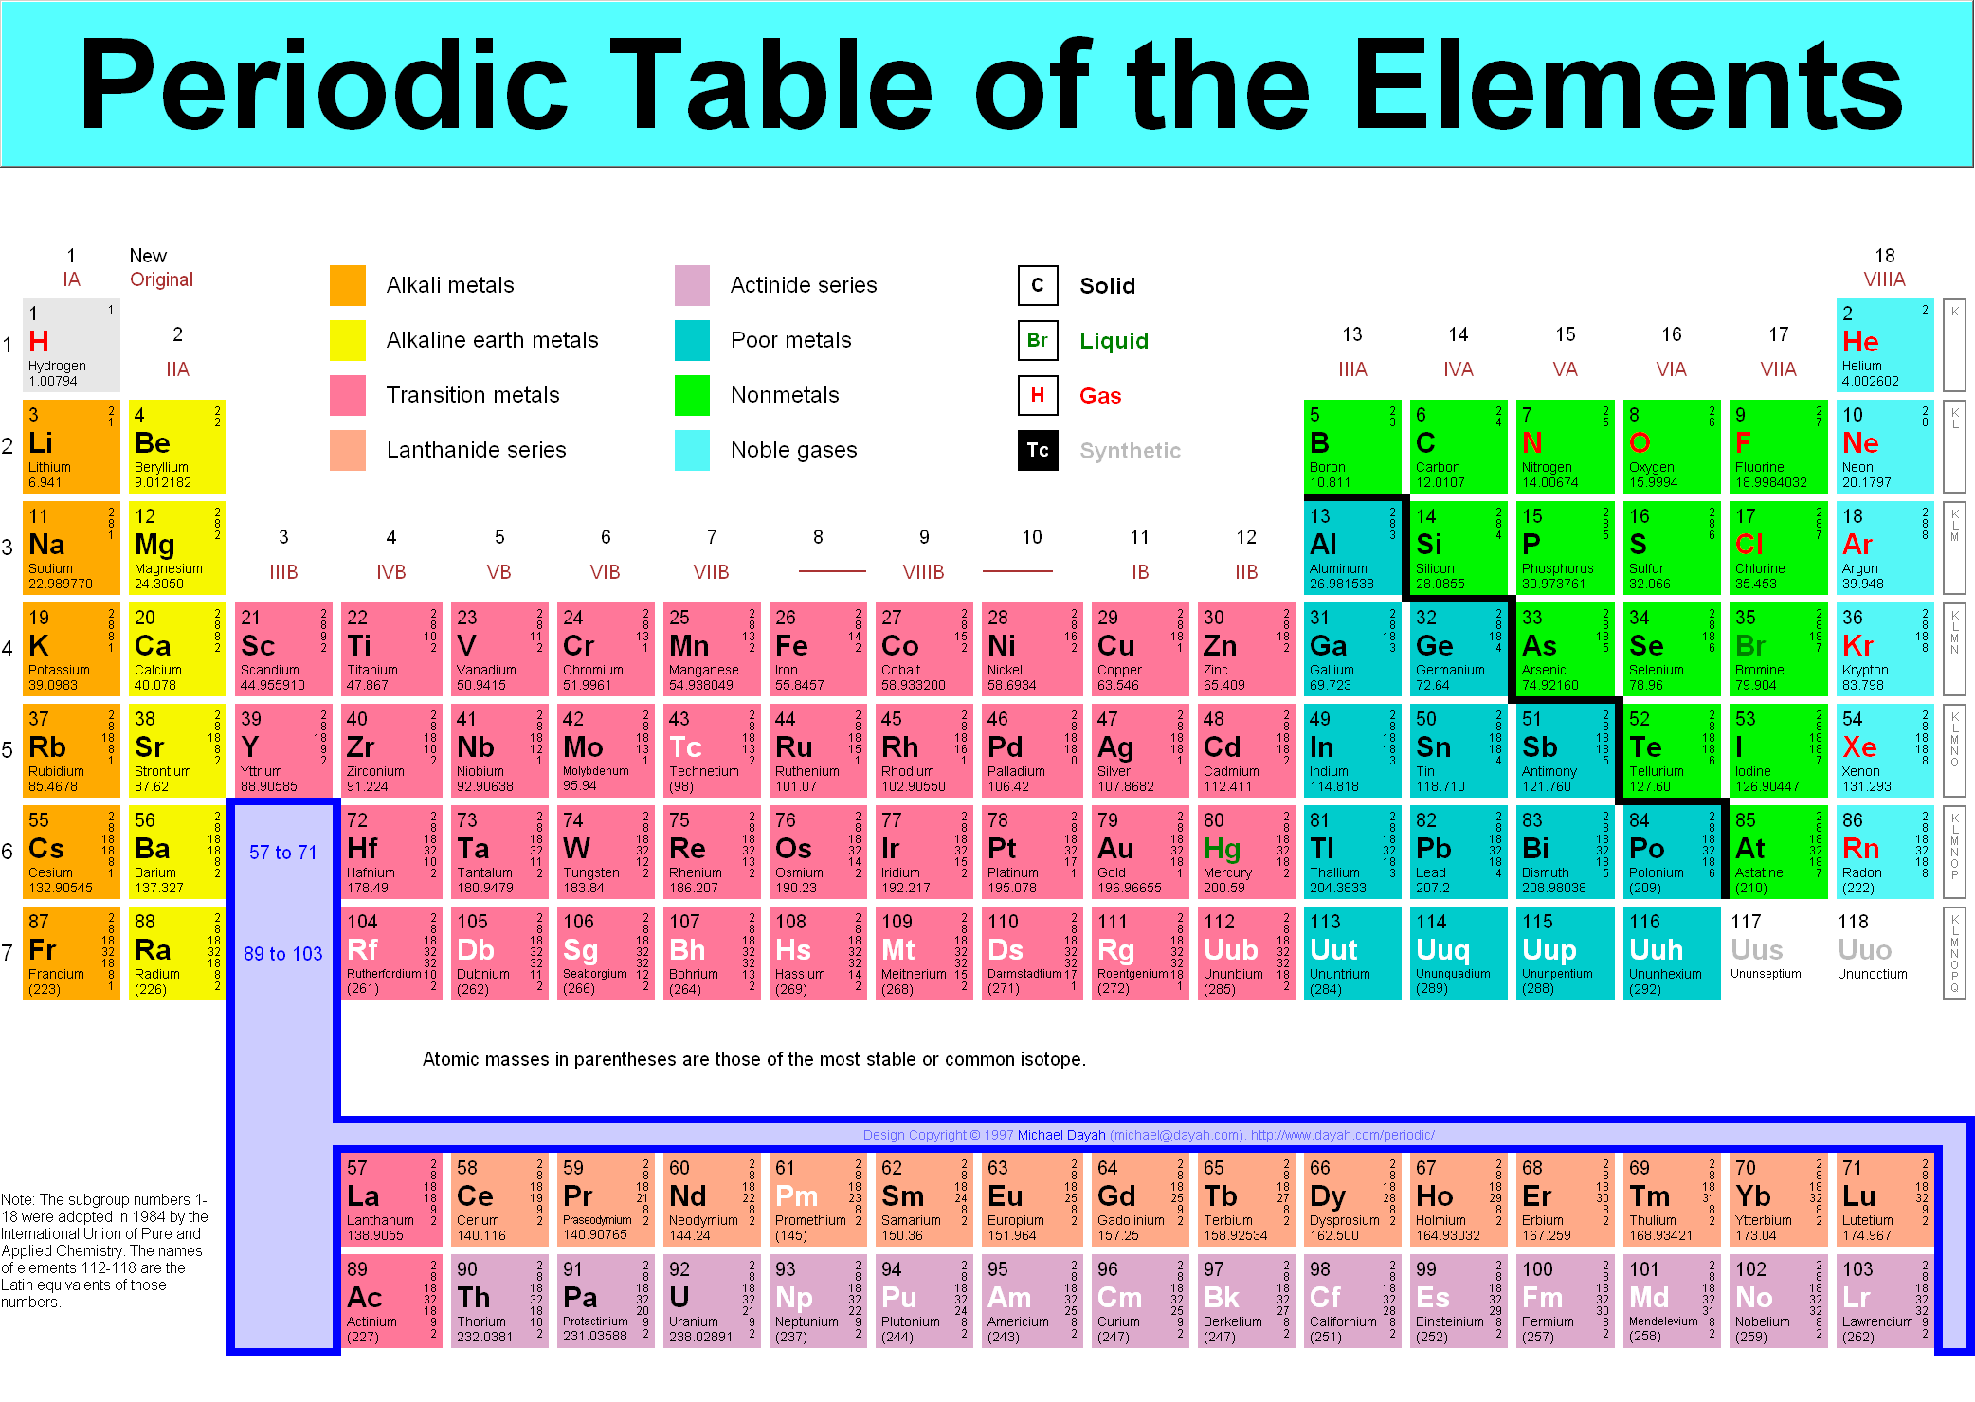

Slide 10
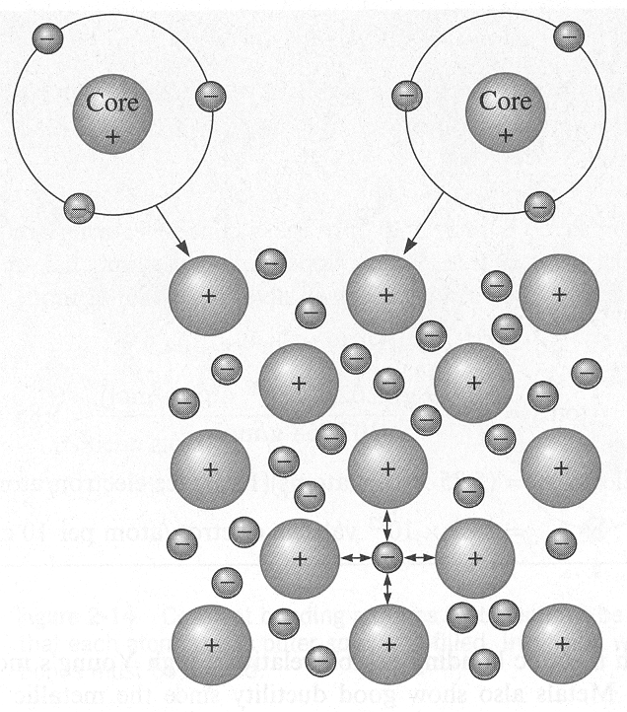
The metallic bond forms when the atoms give up their valence electrons, which then form a “sea” of electrons. The positively charged atom cores are bonded by mutual attraction to the negatively charged electrons.

Slide 11
Metallic Bonds
Materials with metallic bonds tend to be
1) good electrical conductors,
2) be ductile, and
3) have moderate melting temperatures.
  eg.#1, K, 4s¹ ; bonding energy is 89.6 kJ/mole and melting point is 63.5 ºC.
  eg.#2, Ca, 4s² ; bonding energy is 177 kJ/mole and melting point is 851 ºC.
  eg.#3, Ni, 3d⁸ 4s² ; bonding energy is 423 kJ/mole and melting point is 1455 ºC.

Slide 12
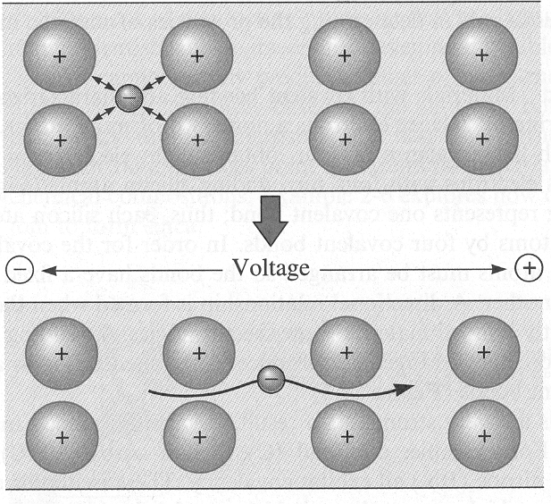
When voltage is applied to a metal, the electrons in the electron sea can easily move and carry a current.

Slide 13
Bonding
Solid solutions:
Consider mixing and water and alcohol. These 2 liquids are completely soluble in each other for all proportions. The mixing occurs on the molecular scale (complete molecular mixing).
All materials used in engineering are “solid solutions”. Even though most pure materials have some impurities, which results in mixing of the material and impurity.
Similar to the mixing of alcohol/water, a solid solution can be created by dissolving nickel (the solute) into copper (solvent). The nickel atoms replace the copper atoms on the FCC atom sites. This is referred to as a “substitutional solid solution”.

Slide 14
Bonding
Solid solutions:
For complete miscibility (mixing) to take place in metallic solid solutions, the 2 metals must be very similar. Hume-Rothery rules define the necessary similarity:
1) less than 15% difference in atomic radii.
2) same crystal structure.
3) similar electronegativities (ability of an atom to attract an electron).
4) same valence.
If any of the above rules are violated only partial solubility is possible.

Slide 15
Bonding
Solid solutions:
When the atom size (atomic radii) are significantly different, the substitution of a smaller atom on an atomic site may not be stable (in terms of energy). In such a case, the smaller atom will fit into an interstitial (space) between the atoms that form the structure. When this occurs, it is called an “interstitial solid solution”.
When the rules are applied to compounds an additional rule must be included. The rule requires charge neutrality when the compounds are mixed.

Slide 16
Bonding
Solid solutions:
For example, Ni²⁺ ions can be readily replace Mg²⁺ ions in an MgO compound.
However, if Al³⁺ ions are used as a replacement, three Mg²⁺ ions will be replaced by two Al³⁺ ions.
This will leave one Mg²⁺ site vacant.

Slide 17
Bonding
Mixture vs. Compound:
The composition of a mixture is variable. The composition of a compound is not variable.
The components of a compound do not retain their individual properties, where as, mixture components do retain their individual characteristic properties. [ i.e. sodium and chlorine are both poisonous; however, their compound NaCl (table salt) is not poisonous].
Large amounts of energy are required to separate the components of a compound. Mixture components are easily separated.

Slide 18
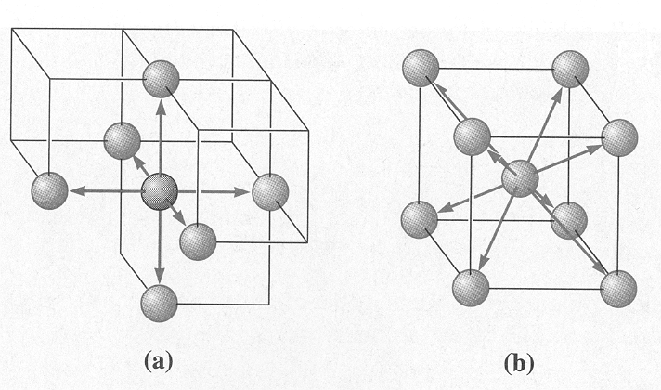
Coordination Number
This is the number of atoms touching a particular atom or the number of nearest neighbors for that particular atom.
It is an indication of how tightly and efficiently the atoms are packed together.
For ionic solids, the coordination number is the number of nearest ions.
We can see below that the Simple Cubic (SC) and Body Centered Cubic (BCC) have a coordination number of 6 and 8, respectively.
The coordination of atoms in the a) SC and b) BBC unit cells.

Slide 19
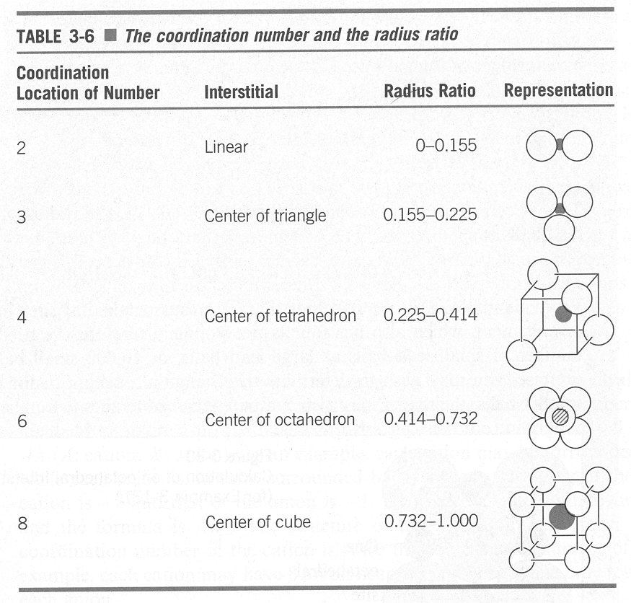
Interstitial Sites in Crystals
We can use the radius ratio between the interstitial atom and host atom to determine the site it prefers to exist.

Slide 20
Packing Factor
This is the fraction of space occupied by atoms, assuming that the atoms are hard spheres.
The general expression for the packing factor is:

Slide 21
Packing Factor
For a FCC cell, there are four lattice points per cell. If there is 4 atoms per lattice point then there are 4 atoms/cell. The packing factor for FCC can be written as:
This is the most efficient packing possible for the “ideal” crystal structure. Higher packing is possible for non-ideal structures.
BCC cells have a packing of 0.68
SC cells have a packing of 0.52
HCP also has a packing of 0.74

Slide 22
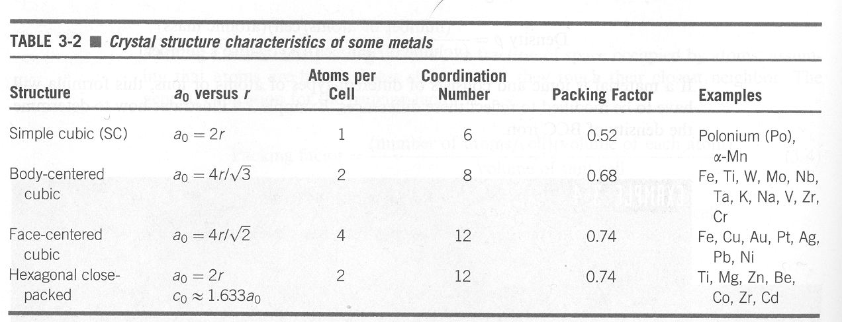

Slide 23
Van der Waals Bonding
These bonds are much weaker than the three primary bonds but are very prevalent in materials, and thus very important.
These bonds are formed by electrostatic attraction between groups of atoms or molecules that are either permanently polarized or dynamically polarized (i.e., changing as in a chemical process).
They possess an electric dipole moment
  eg., H₂O where the oxygen is more strongly electronegative than H so O shares H₂’s electrons giving oxygen a negative potential and H a positive potential.
Many organic molecules, polymers, and ceramics exhibit this type of bonding, often referred to as “hydrogen” bonding” with permanent polarization on an atomic level.
  These weak bonds enable life’s processes to occur such as photosynthesis and the “Hydrogen Cycle”.

Slide 24
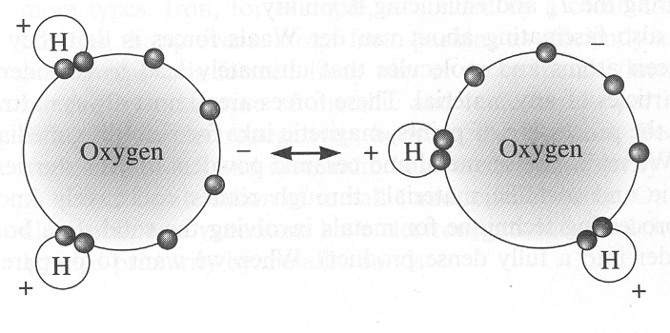
In water, electrons in the oxygen tend to concentrate away from the hydrogen. The resulting charge difference permits the molecule to be weakly bonded to other water molecules by Van der Waals forces.

Slide 25
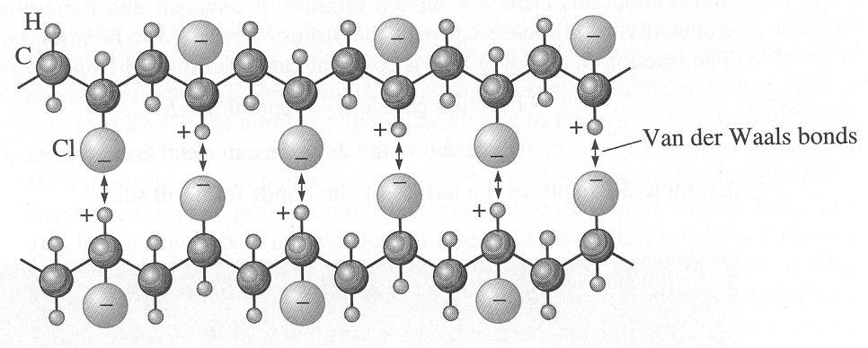
Van der Waals Bonding
Van der Waals bonding can change the properties of a material substantially.
eg., for long chained carbon molecules, polymers are covalently bonded and hence might be expected to be brittle. The long chain molecules are bonded together between the chains by Van der Waals bonds so ductility is obtained by the distortion of the weak bonds rather than between the strong covalent bonds along the chain itself.
In Polyvinyl Chloride (PVC), the chloride atoms attached to the polymer chain have a negative charge and the hydrogen atoms are positively charged enabling van der Waals bonding.

Slide 26
Bonding
Bonding character of the four fundamental types of engineering materials.
Material type Bonding Character Example
Metal Metallic Iron and Ferrous alloys
Ceramics Ionic/covalent Silica (SiO₂)
and glasses (Crystalline & non-crystalline)
Polymers Covalent & Secondary Polyethylene (C₂H₄)
Semiconductors Covalent Silicon (Si) or covalent/ionic Cadmium sulfide (CdS)

Slide 27
Bonding
Covalent
Semi conductors
Polymers
Metallic
Secondary
Metals
Ceramics and glasses
Ionic
A 3-D tetrahedron representing the relative contributions of different bond types to the four fundamental categories of engineering materials.

Slide 28
Allotropic & Polymorphic
Materials that can have more than one crystal structure are called allotropic or polymorphic.
Allotropy refers to pure elements, which change their structure when they are heated for example.
  Iron is an example which has a BCC structure at low temperatures and FCC structure at high temperatures.
Polymorphism is used for compounds.
  Zirconia, ZrO₂ is an example, which is monoclinic at room temperature, tetragonal at higher temperatures (>1170 C) and cubic at very high temperatures (> 2370 C).
Often a volume change is associated with a phase change in polymorphic materials.

Slide 29
Theoretical Volume Changes
Polymorphic materials upon changing their phase or crystal structure experience volume changes due to a difference in lattice parameters associated with the phase. For example, ZrO₂ changes it phase from tetragonal to monoclinic with temperature.
Thus there is an expansion of the unit cell of 4.21% as Zirconia transforms from a tetragonal to monoclinic form.
The volume expansions or contractions affect brittle materials adversely such as Zirconia and other ceramic and semiconductor materials by causing fracture.
Zirconia is modified by additives (eg. CaO, MgO, Y₂O₃) to retain its cubic form upon cooling to room temperature.
Cubic Zirconia is used for jewelry and the electronics industry.

Slide 30
Crystalline Imperfections
Real materials are never perfect and contain various types of imperfections, which affect many of their properties.
Some properties affected by imperfections include tensile and ultimate strengths, thermal conductivity, electrical conductivity, photonic generation and conductivity, magnetic properties, etc.

Slide 31
Crystalline Imperfections
Crystal lattice imperfections are classified according to their geometry and shape.
Point defects are zero dimension
Line defects are one dimensional
Planar defects are two dimensional and comprise of free surfaces and grain boundaries
Volume defects are cavities or voids filled with gas or consist of a vacuum.

Slide 32
Crystalline Imperfections
The simplest example of a point defect is a vacancy, which is an atomic site from which an atom is missing.
Questions arise about the properties of vacancies:
  What is the density of vacancies in real materials?
  How can vacancies move through the crystal?
  How can these defects be formed?

Slide 33
Crystalline Imperfections
The second type of point defect is a self-interstitial atom (SIA).
A SIA is an atom, which has moved off a regular atomic site into an interstitial site.
The atom represents the material, e.g., Fe in steel, therefore “self-interstitial”, as opposed to an impurity-interstitial (Oxygen in steel) or solute-interstitial (Carbon in steel).
The SIA is usually energetically unstable , since the atom prefers to be in its normal lattice position.
Impurity atoms can be purposely introduced to modify the properties of the crystal. These impurity atoms are called “dopants”.

Slide 34
Crystalline Imperfections
In ionic crystals, point defects are more complicated because the lattice must maintain charge neutrality.
When two oppositely charged ions are missing from an ionic crystal, a cation-anion divacancy is created, called a “Schottky” imperfection.
When a cation moves out of place next to another cation, a cation vacancy is produced, called a “Frenkel” imperfection.
Cation: Positively charged ion
Anion: Negatively charged ion

Slide 35
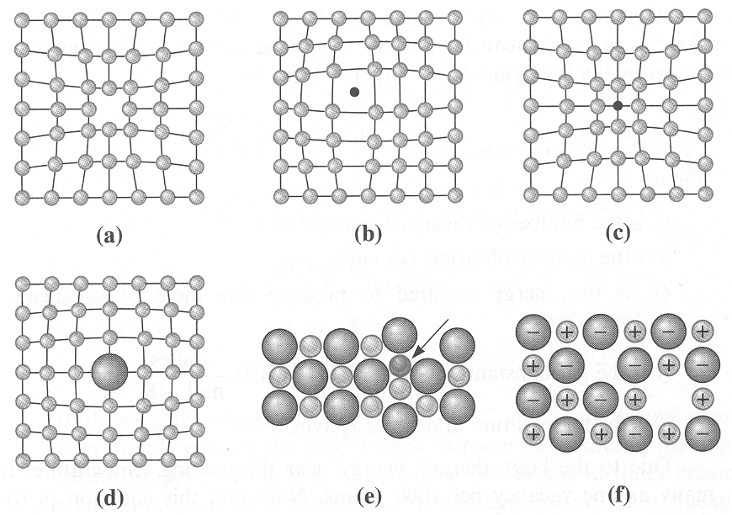
Point Defects
Point Defects: a) vacancy, b) interstitial, c) small substitutional, d) large substitutional, e) Frenkel defect and f) Schottky defect.

Slide 36
Point Defects
Vacancies and interstitial increase their concentration in materials exponentially with temperature and obey the Arrenhius equation, for vacancies given as,
Where:
C = a pre-exponential constant
Ev = the energy to form a single vacancy
k = Boltzmann’s constant (8.62 *10⁻⁵eV/K) or
(13.8*10⁻²⁴ J/K)
T = temperature (in absolute degrees, i.e. Kelvin or Rankine)
This equation can be linearized by taking the natural logarithm of each side.

Slide 37
Point Defects
This equation can be linearized by taking the natural logarithm of each side.

Slide 38
Point Defects
Slope = E_{v} / K

